Slide 1

Weather Conditions and Climate Change with ClimateWins
Kaan ARSLAN
kaan@kaanarslan.com

Slide 2

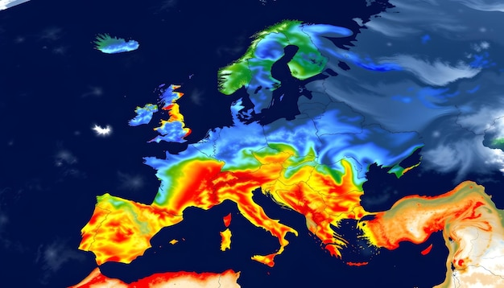
Weather Conditions and Climate Change with ClimateWins
<//
//>
Objective
• Identify weather patterns that fall outside normal regional behavior in Europe.
• Determine whether unusual or extreme events are becoming more frequent.
• Generate realistic possibilities for European climate conditions over the next 25–50 years.
• Evaluate which European regions will be the safest to live in as climate volatility increases over the next 25-50 years.

Slide 3
ML techniques during the execution of the project
<//
//>
CNN - (Weather Station Classification)
I optimized a CNN for station-based classification to test how architectural changes influence performance.
A CNN trained on station data improved dramatically from 10.23% → 75.95% accuracy after hyperparameter optimization. The tuned model produced much cleaner confusion matrices but concentrated predictions on fewer stations.
CNN (Weather Image Classification)
A CNN was applied to classify radar style weather images because convolutional layers are effective at learning visual patterns. The model reached 93.9% train accuracy and 87.95% validation accuracy and correctly predicted real photographs
Random Forest
Random Forest was used to understand which meteorological variables have the strongest influence on pleasant/unpleasant conditions. The model consistently highlighting max temperature, precipitation and mean temperature as the major drivers.
GAN - (Synthetic Weather Scenario Exploration)
GAN were explored conceptually to generate synthetic climate samples and extreme event scenarios.
Allows ClimateWins to simulate long term climate possibilities beyond available historical data.
GAN can support forecasting in areas with missing, sparse or inconsistent climate records.

Slide 4

Proposed machine learning strategy
<//
//>
To meet ClimateWins’ long-term goals, I propose three research directions:
GAN based synthetic climate generator
Generate realistic long range climate scenarios to fill gaps in historical data and simulate multiple future paths, supporting ClimateWins’ 25–50 year forecasting objective.
LSTM multi variable climate trend forecaster
Model temperature, precipitation, humidity and wind trajectories using sequential dependencies to identify long term directional shifts and detect whether abnormal patterns are accelerating across Europe.
Random forest extreme event early warning classifier
Learn which meteorological variables are early indicators of extreme events (heatwaves, storms, cold spells).
Provides interpretable feature importance to support decision makers and risk planning.

Slide 5
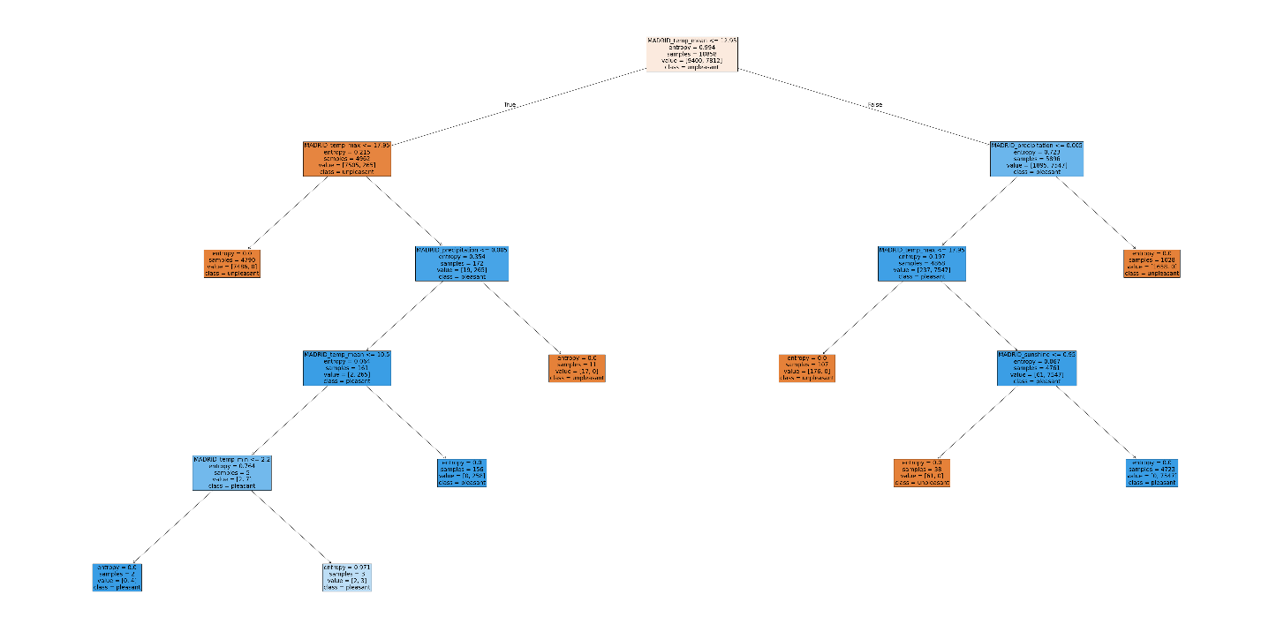
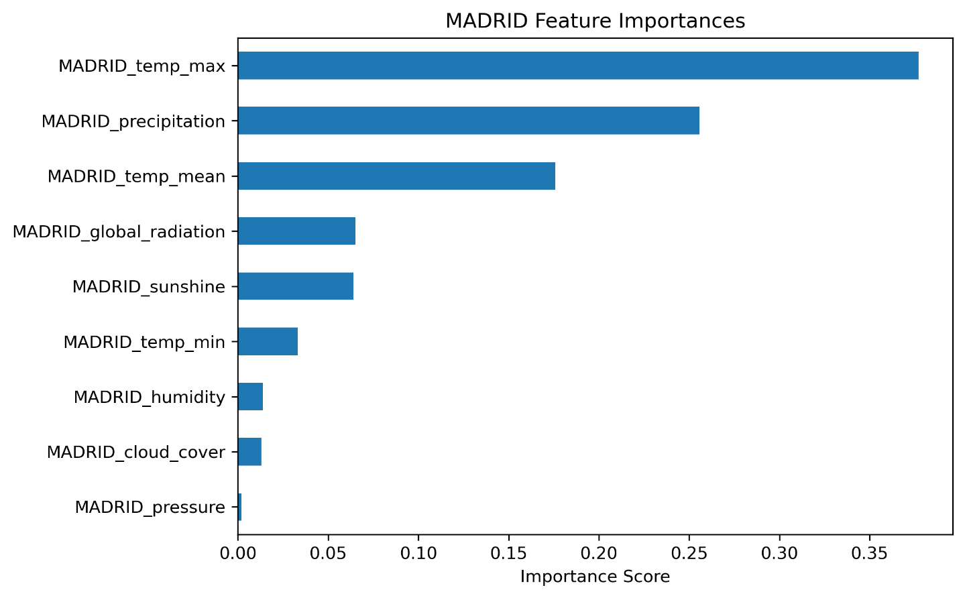
Thought experiment 1
<//
//>
Random forest extreme event early warning classifier
Objective:
• Identify weather outside normal patterns.
• Evaluate future regional safety in Europe.
Concept:
A Random Forest model can classify whether current atmospheric conditions are leading toward an extreme event. By analyzing feature importance, the model also reveals which physical signals serve as the earliest warnings.
Why Random Forest:
In this project, I used Random Forests to interpret non linear interactions and identify the most influential variables. Their transparency makes them ideal for safety critical forecasting where explainability matters.
Data Required:
• Historical catalogues of extreme events with timestamps.
• Historical weather data 1960-2020.
Expected Output:
A classifier that assigns a “risk score” for extreme events enabling more accurate early warning systems.
Example: Decision tree and feature importance for Madrid station

Slide 6
Thought experiment 2
<//
//>
GAN based synthetic climate scenario generator
Objective Supported:
• Generate possible future climate conditions (25–50 years).
• Identify the safest place to live in Europe in future.
Concept:
GAN can learn Europe’s historical climate distribution and then generate thousands of realistic weather sequences. This synthetic data expands beyond the limited changes observed in recent decades and models low frequency, high impact events
Why GAN:
GAN excel at approximating complex, multi modal distributions that cannot be captured by traditional statistical models. They can produce many plausible futures rather than one deterministic prediction.
Data Required:
• Historical weather data 1960-2020
• Topographic and regional climate classifications.
Expected Output:
A library of “future climate scenarios” to stress test infrastructure, agriculture and long term planning.

Slide 7
Thought experiment 3
<//
//>
LSTM based multi variable climate trend forecasting
Objective Supported:
• Identify abnormal patterns.
• Predict regional climate evolution over multiple decades.
Concept:
A multi input LSTM network ingests decades of European weather records and learns long range temporal relationships between temperature, humidity, wind, pressure and precipitation. The model forecasts how these variables will drift over time and flags deviations from historical norms.
Why LSTM:
LSTM retain long term context far better than classical models. During this project, I applied LSTM architectures to time series data and achieved strong validation accuracy.
Data Required:
• Historical weather data 1960-2020
• Land use and urbanization changes.
Expected Output:
Continuous long-term climate trend predictions with anomaly scores indicating unusual pattern shifts.

Slide 8
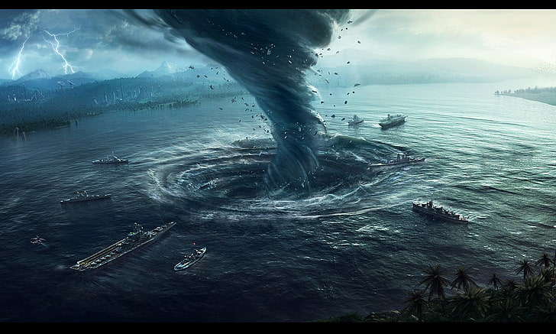
Strategy & Recommendations
<// //>
1. Random Forest ( Extreme event early warning)
• Fast, explainable, operationally deployable.
• Identifies early signs of storms, heatwaves and abnormal patterns.
2. LSTM ( Long term climate trend forecasting)
• Captures multi decade climate drift.
• Essential for detecting whether anomalies are increasing.
3. GAN (Synthetic climate scenarios)
• Generates multiple future climate trajectories.
• Supports long term planning and risk exploration.
Next Steps:
• Expand datasets beyond historical records.
• Build regional models for Europe.
• Validate against extreme event timelines.
• Integrate all three models into a unified ClimateWins pipeline.

Slide 9
<//Contact//>
kaan@kaanarslan.com
kaan@kaanarslan.com
Github & Tableau public
CREDITS: This presentation template was created by Slidesgo, including icons by
Flaticon and infographics & images by Freepik

